Slide 1
Logo animation (intro)

Slide 2

Title slide
Code Café
Visualgo
Code QL
29 februari 2024

Slide 3

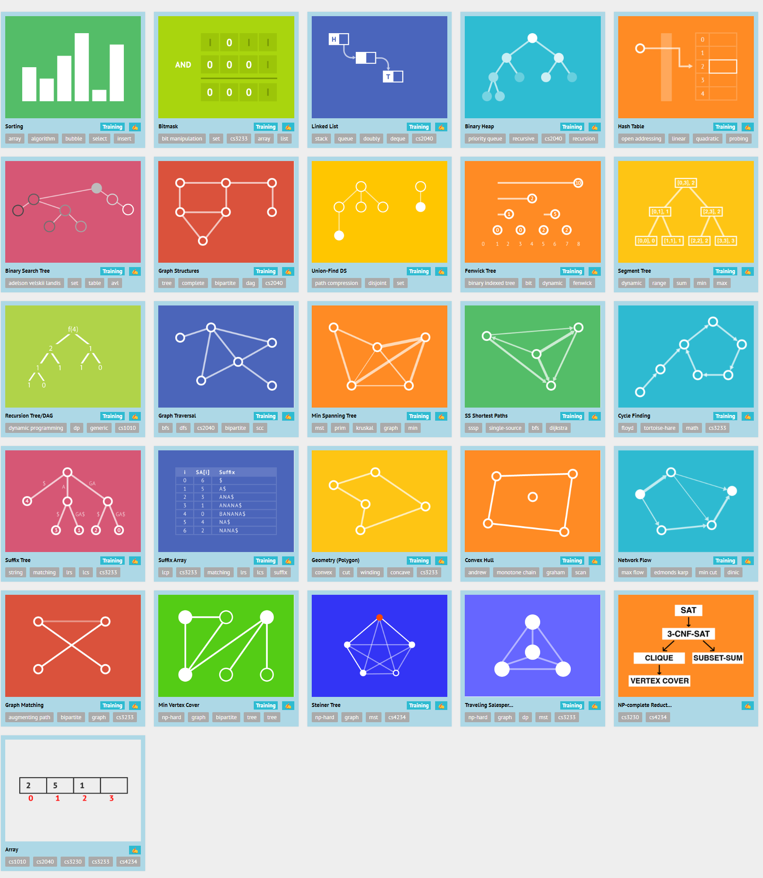
vISUALGO
A website: visualgo.net
Visualizing Data Structures and Algorithms
through animation
Notes:
https://visualgo.net/

Slide 4
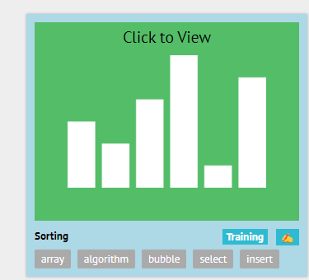
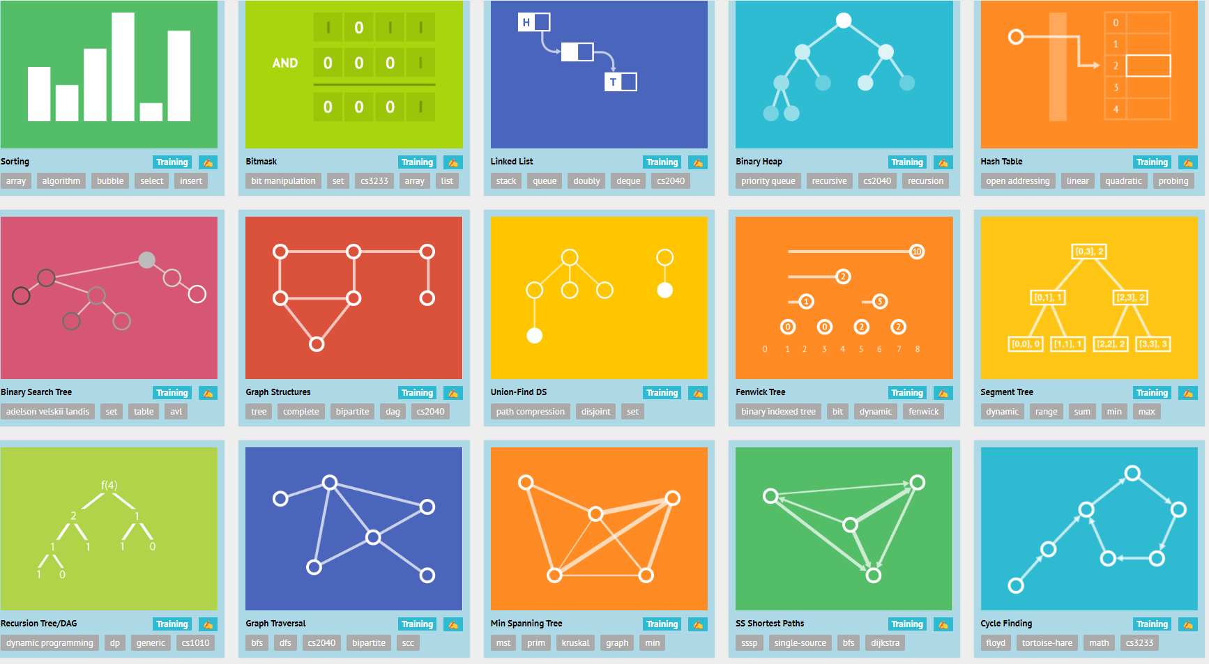
vISUALGO
Notes:
https://visualgo.net/

Slide 5
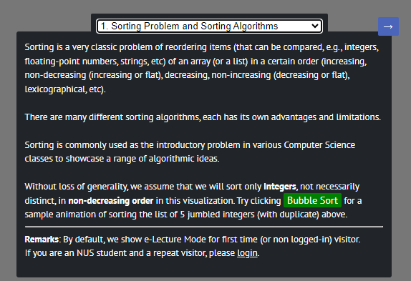
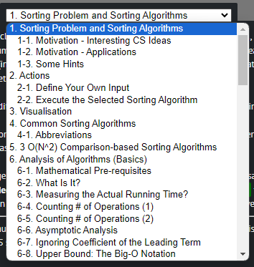
vISUALGO
Notes:
https://visualgo.net/

Slide 6
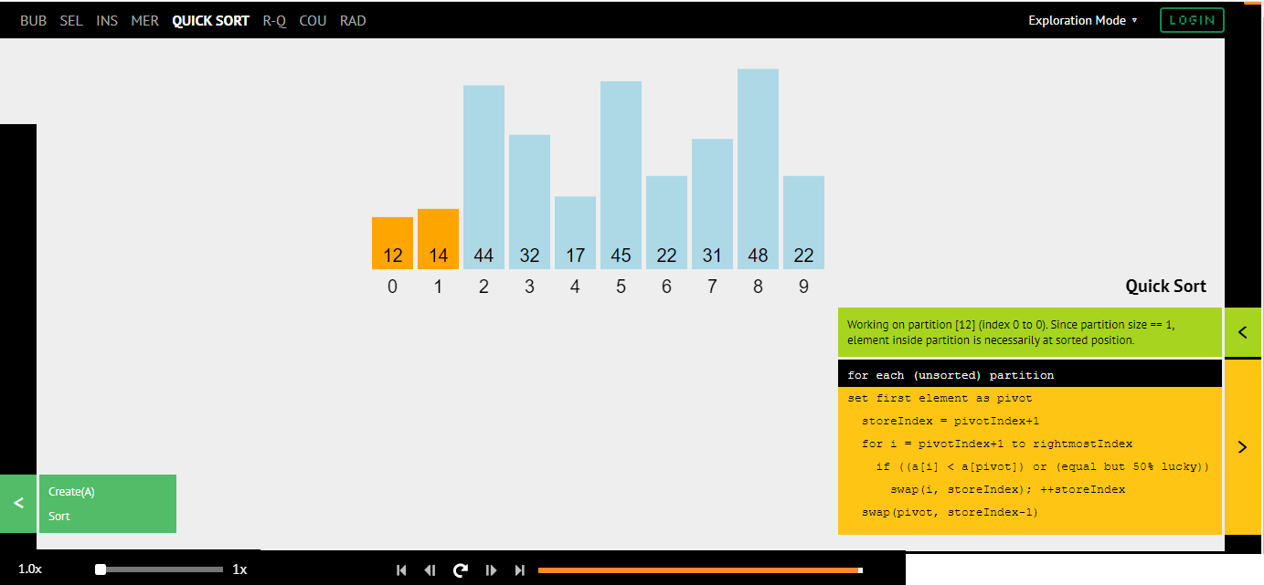
vISUALGO
Notes:
https://visualgo.net/

Slide 8

Code QL
semantic code analysis engine to perform [automated] security checks on code
Or to run QA validations against code guidelines
Or to analyze your code in other ways
Using a SQL-like query language

Slide 9





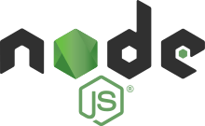




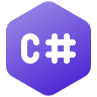

Code QL
Code
Code QL Database

Slide 10
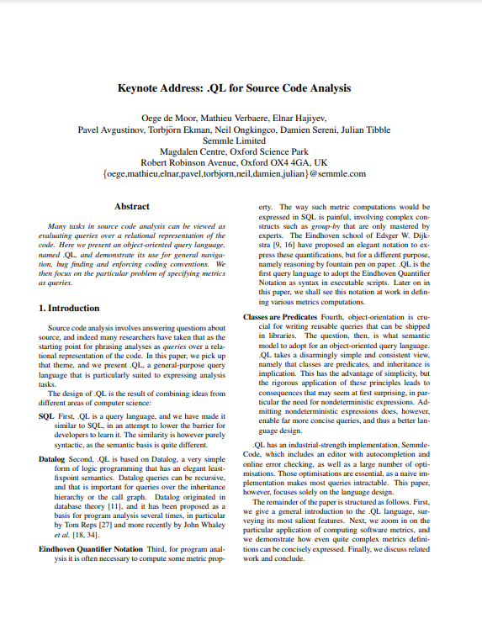


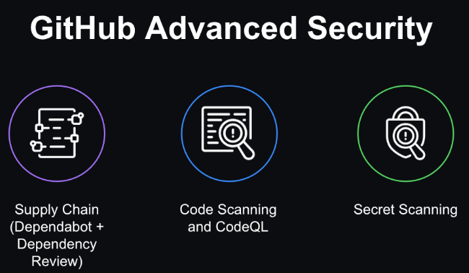
code QL
Developed by Semmle
origin 2006 – academic research by Oege de Moor and teams (Oxford University)
made public as part of LGTM.com – from 2017 onwards
Semmle was acquired by GitHub in 2019
GitHub made CodeQL available for free for public repositories and scientific research
for private code, the GitHub Advanced Security License is required
GitHub Code Scanning is powered by CodeQL
Notes:
https://github.blog/2022-08-15-the-next-step-for-lgtm-com-github-code-scanning/#explore
https://github.blog/changelog/label/codeql/
CodeQL is a powerful tool developed for software security analysis, allowing developers and security researchers to query code as if it were data. Its history is intertwined with the development of semantic code analysis techniques and the broader evolution of software security practices. Here are some of the major milestones in the history of CodeQL:
Early Foundations and Semmle Formation (2006-2007): The foundations of CodeQL can be traced back to research and development work on semantic code analysis by Oege de Moor, a professor at the University of Oxford, and his team. This work led to the formation of Semmle, the company behind CodeQL, in 2006.
Launch of CodeQL and QL Language (2007-2008): Semmle officially launched CodeQL and its query language, QL, designed to allow querying codebases for patterns and metrics in a way similar to querying databases. This marked a significant advancement in the field of code analysis, enabling deep, semantic analysis of code for security vulnerabilities and other issues.
Expansion and Adoption (2009-2017): Over the years, CodeQL and its underlying technology saw significant improvements and expansion in capabilities. Its adoption grew among large tech companies and organizations concerned with software security, due to its effectiveness in identifying vulnerabilities that traditional static analysis tools might miss.
Acquisition by GitHub (2019): In a major development, GitHub announced the acquisition of Semmle in September 2019. This was a strategic move to integrate CodeQL's powerful code analysis capabilities directly into GitHub's platform, enhancing security for millions of repositories.
Integration into GitHub Security Features (2020-onwards): Following its acquisition, GitHub integrated CodeQL into its security features, including GitHub Advanced Security. This integration made CodeQL's advanced security analysis capabilities available to a wider audience, promoting better security practices across the software development industry.
CodeQL Contributions and Community Growth (2020-onwards): With its integration into GitHub, CodeQL's community of users and contributors has grown significantly. GitHub has encouraged community contributions to CodeQL's query library, leading to a rapid expansion in the tool's capabilities and the number of languages it supports.
Open-Source and Free for Public Repositories (2020-onwards): GitHub made CodeQL free for all public repositories on its platform, promoting better security practices across open-source projects. This move has facilitated the discovery and patching of numerous vulnerabilities in open-source software.
Continued Innovations and Language Support Expansion: GitHub and the broader community continue to innovate and expand CodeQL's capabilities, including adding support for more programming languages and enhancing its analysis techniques. This ongoing development ensures that CodeQL remains at the forefront of semantic code analysis technology.

Slide 11
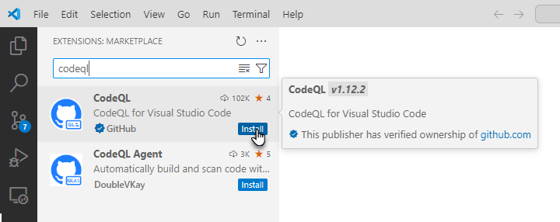
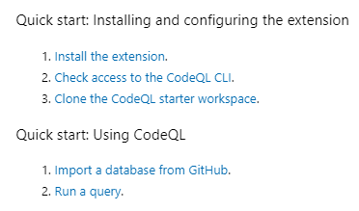
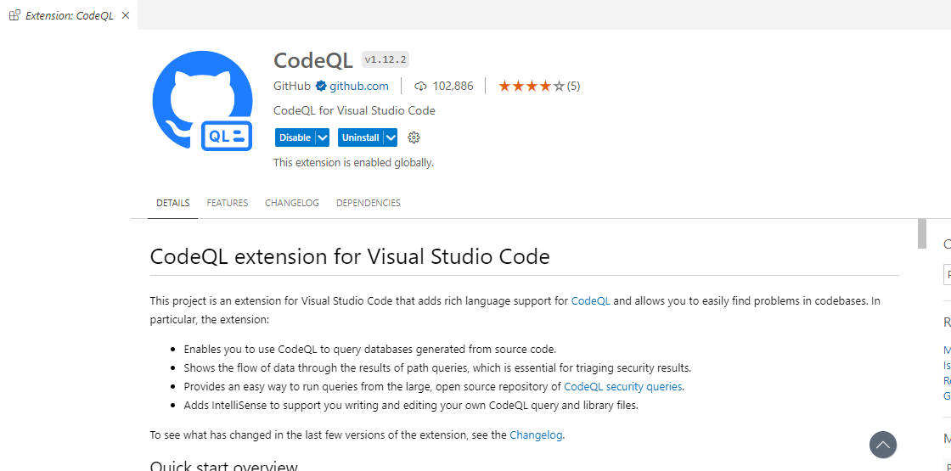
Get going with code QL in Visual Studio COde

Slide 12
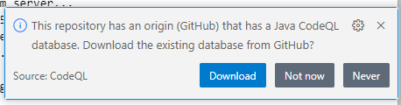
Steps for code ql on your own code
Install CodeQL extension in VS Code
Generate database for your own project / GitHub repo
for compiled languages, this involves building the code
or find and download existing database
Notes:
C:\Users\lucas_j\AppData\Roaming\Code\User\globalStorage\github.vscode-codeql\distribution1\codeql
set PATH "%PATH%;C:\Users\lucas_j\AppData\Roaming\Code\User\globalStorage\github.vscode-codeql\distribution1\codeql"

Slide 13
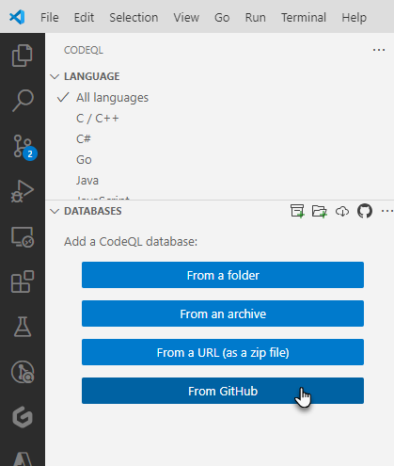
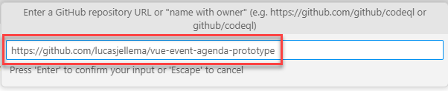
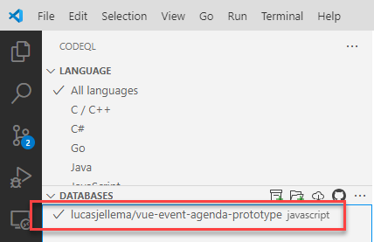
In eligible github repositories…
Under certain conditions, a repository on GitHub is already equipped with a CodeQL Database (it seems)

Slide 14
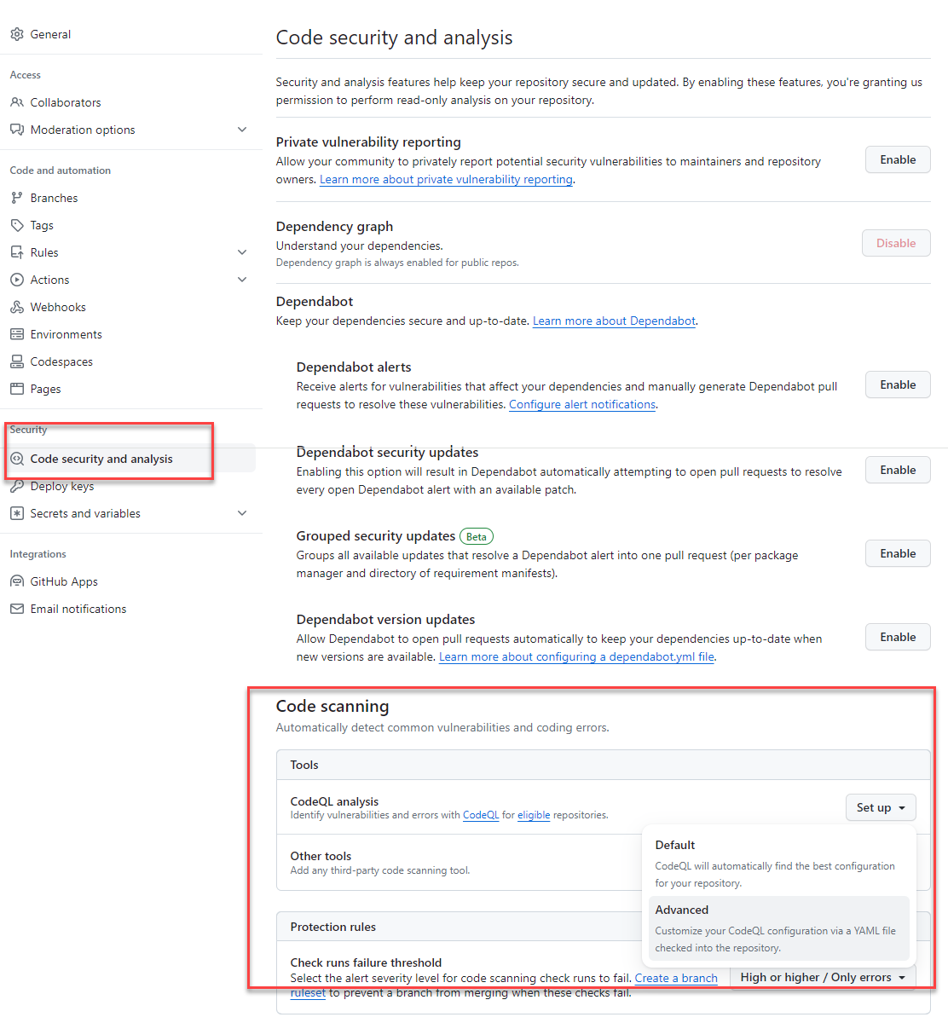
In eligible github repositories…
Under certain conditions, a repository on GitHub is already equipped with a CodeQL Database (it seems)
Additional configuration can be done in GitHub project settings

Slide 15
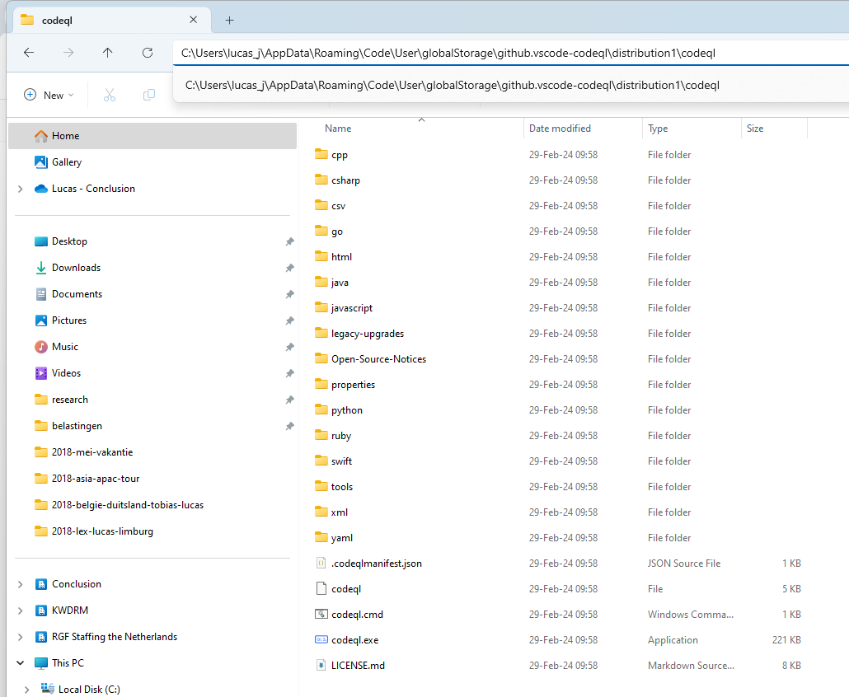
Generate CodeQL database for your own project (1)
Find location of CodeQL CLI – as managed by VS Code extension
Notes:
C:\Users\lucas_j\AppData\Roaming\Code\User\globalStorage\github.vscode-codeql\distribution1\codeql
set PATH "%PATH%;C:\Users\lucas_j\AppData\Roaming\Code\User\globalStorage\github.vscode-codeql\distribution1\codeql"

Slide 16
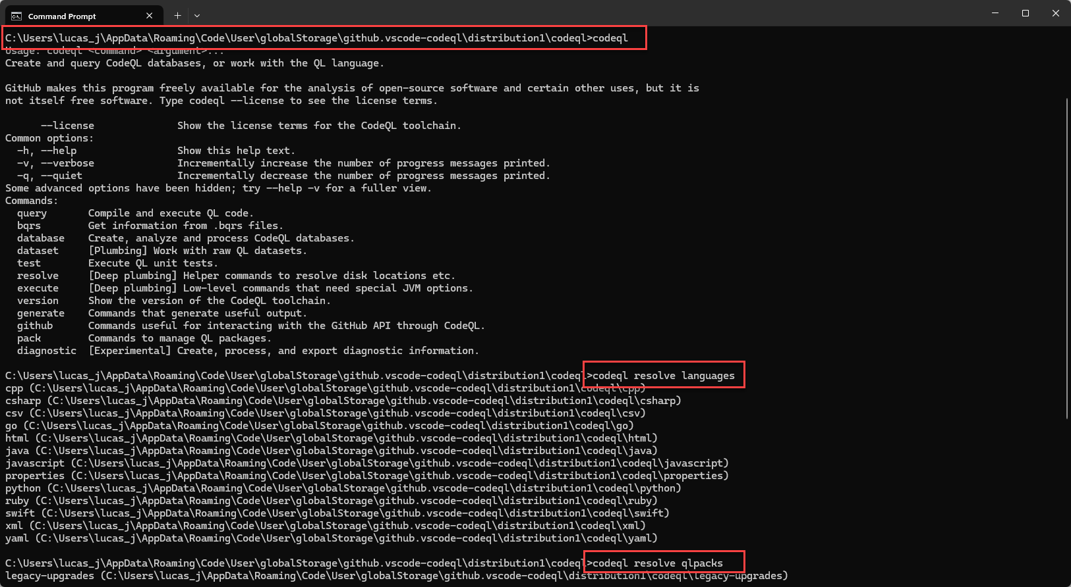
Generate CodeQL database for your own project (2)
Verify you can run the CLI
Run two commands:
codeql resolve languages
codeql resolve qlpacks
Probably not really necessary
Notes:
C:\Users\lucas_j\AppData\Roaming\Code\User\globalStorage\github.vscode-codeql\distribution1\codeql
set PATH "%PATH%;C:\Users\lucas_j\AppData\Roaming\Code\User\globalStorage\github.vscode-codeql\distribution1\codeql"

Slide 17
Generate CodeQL database for your own project (3)
In VS Code, open a terminal in root of your project
Run codeql database create command for current project: C:\Users\lucas_j\AppData\Roaming\Code\User\globalStorage\github.vscode-codeql\distribution1\codeql codeql create database <name-of-database> --language=<languages for which to generate database>
You can use switch –source-root to indicate the root of the project check out location
Notes:
https://docs.github.com/en/code-security/codeql-cli/getting-started-with-the-codeql-cli/preparing-your-code-for-codeql-analysis

Slide 18
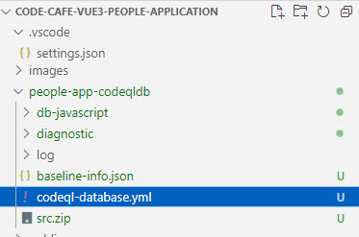
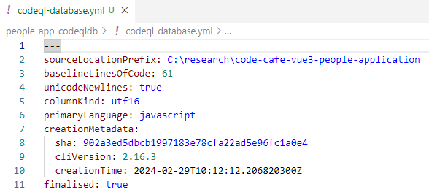
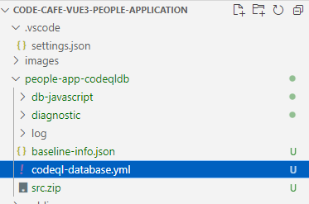
Generate CodeQL database for your own project (4)
This process can take quite a while
Eventually the database is prepared:
Notes:
C:\Users\lucas_j\AppData\Roaming\Code\User\globalStorage\github.vscode-codeql\distribution1\codeql
set PATH "%PATH%;C:\Users\lucas_j\AppData\Roaming\Code\User\globalStorage\github.vscode-codeql\distribution1\codeql"

Slide 19
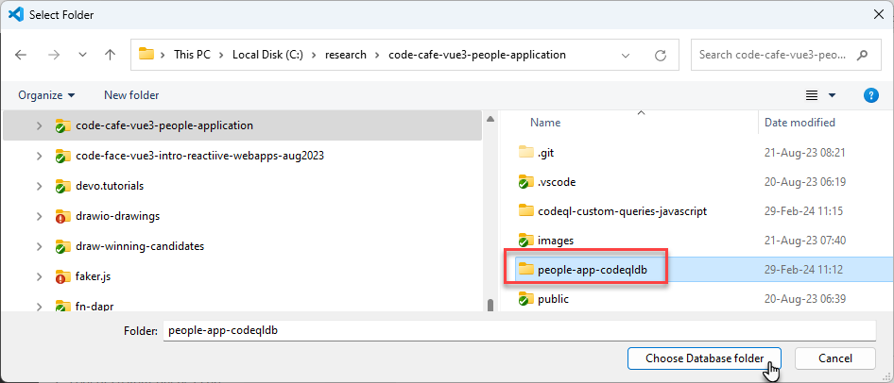
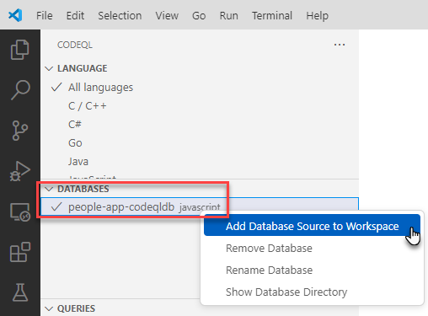
Steps for code ql on your own code
Open CodeQL Starter Workspace in VS Code
Select the generated Code QL database in the Code QL extension
add Database Source Code (for deeplink from query results)
Notes:
C:\Users\lucas_j\AppData\Roaming\Code\User\globalStorage\github.vscode-codeql\distribution1\codeql
set PATH "%PATH%;C:\Users\lucas_j\AppData\Roaming\Code\User\globalStorage\github.vscode-codeql\distribution1\codeql"

Slide 20
Steps for code ql on your own code
Run pre-defined queries for [security] analysis
inspect and publish results
Create and run custom queries
Inspect and publish results
Inspect Abstract Syntax Tree (AST)
Notes:
C:\Users\lucas_j\AppData\Roaming\Code\User\globalStorage\github.vscode-codeql\distribution1\codeql
set PATH "%PATH%;C:\Users\lucas_j\AppData\Roaming\Code\User\globalStorage\github.vscode-codeql\distribution1\codeql"

Slide 21
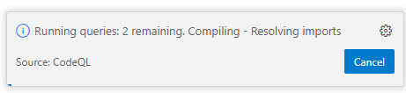
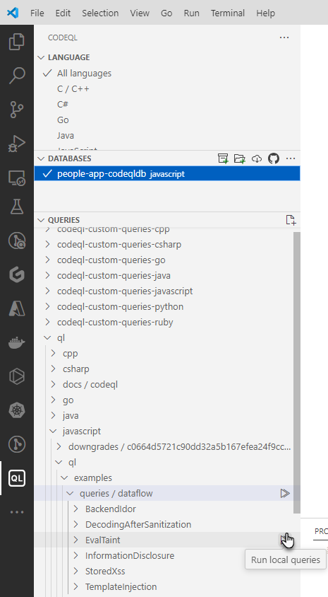

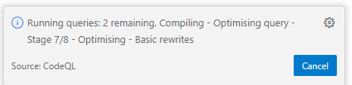
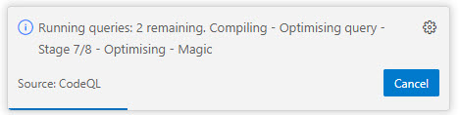
Run predefined queries on codeQL database
Select queries to run
Then wait

Slide 22
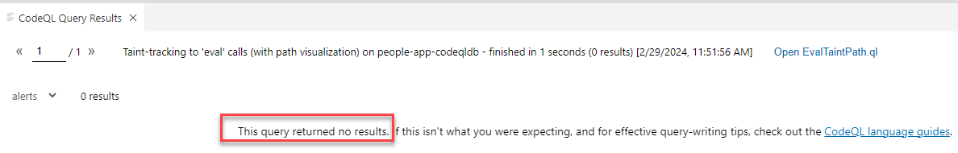
results

Slide 23
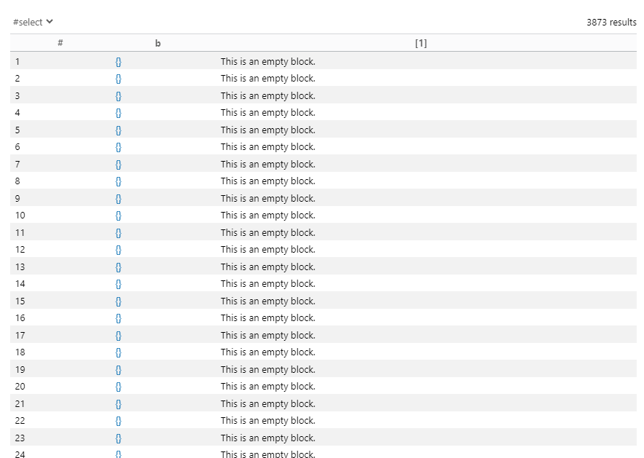
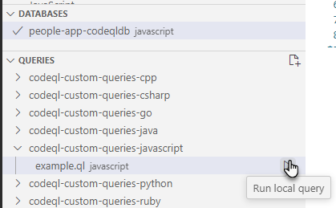
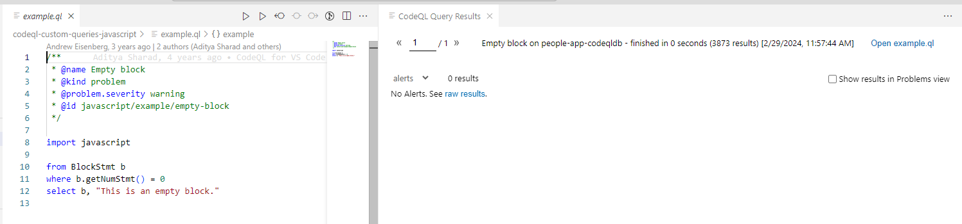
Run the example custom query

Slide 24
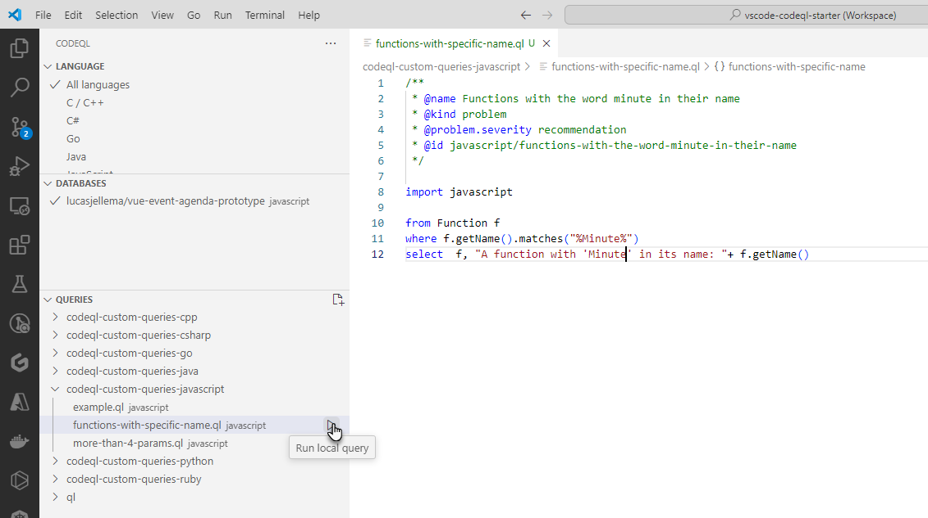
my own (silly) custom query

Slide 25
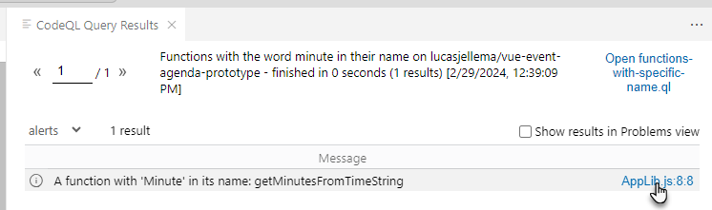
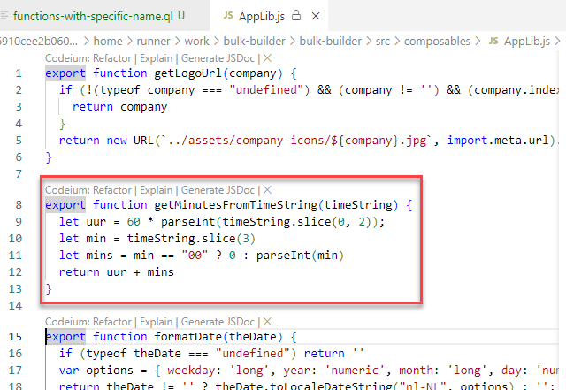
my own (silly) custom query
Notes:
https://codeql.github.com/docs/codeql-language-guides/data-flow-cheat-sheet-for-javascript/

Slide 26
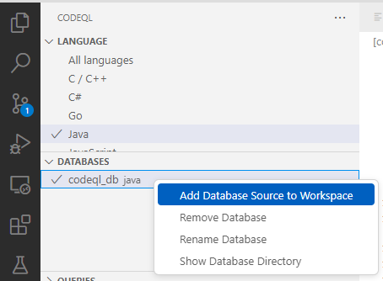
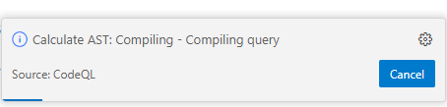
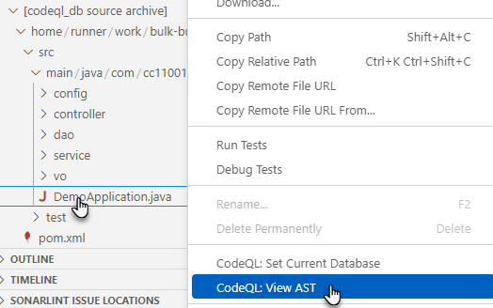
Generate and inspect Abstract Syntax Tree
Add Source Code from Code QL Database to Workspace
View AST Tree for a source file in the project

Slide 27
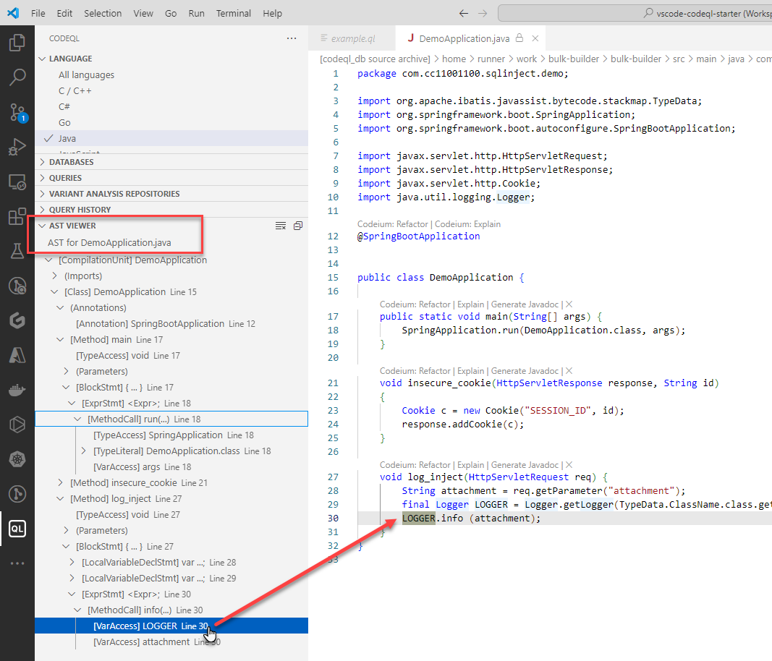
Inspect Abstract Syntax Tree
Synchronization between AST elements and actual source file
Inspecting AST helps with composing custom queries

Slide 28
Miscellaneous
You can exclude directories and files from a CodeQL code scan

Slide 29
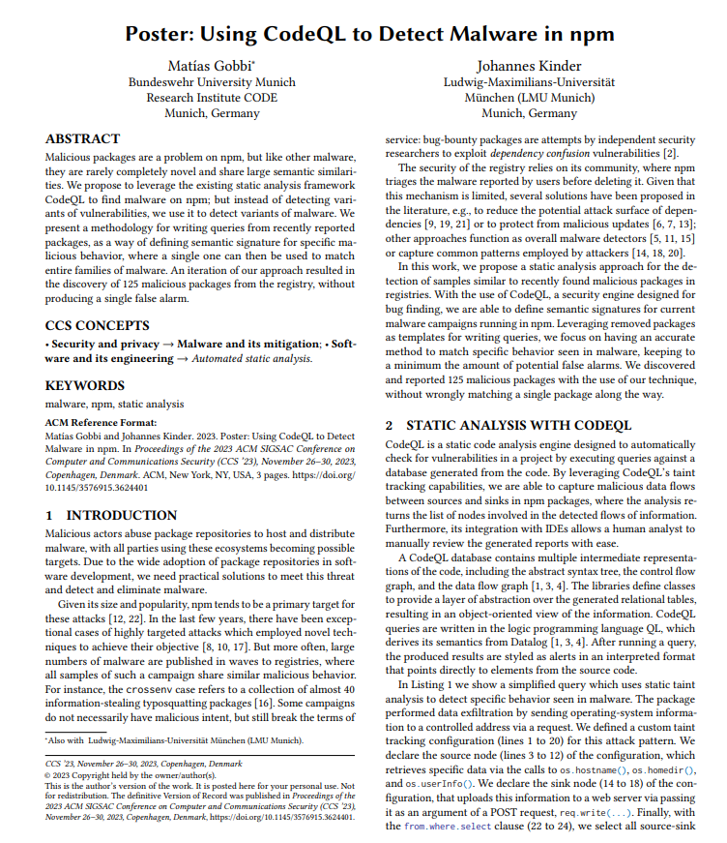
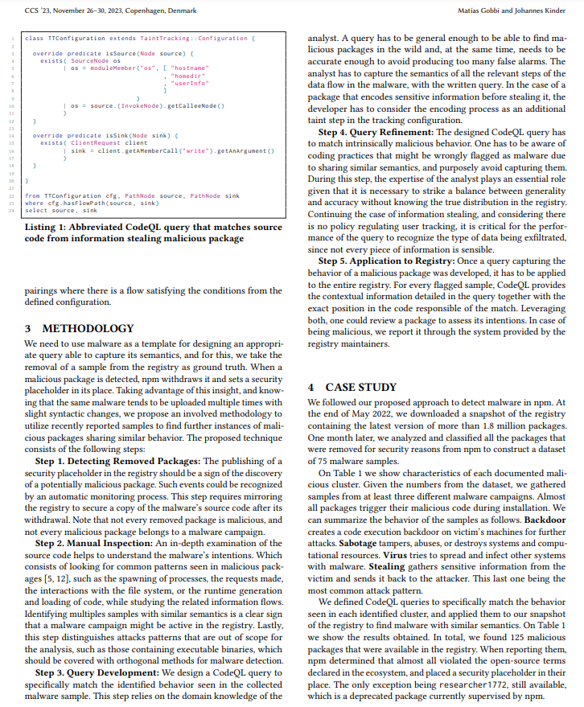
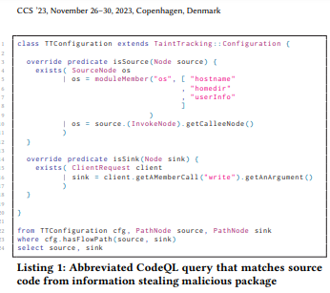
Next steps
Try out
Create some custom queries – for various purposes
Check community provided queries
Share experiences

Slide 30
Logo
www.conclusion.nl

